Slide 1
The NFl
Diversity

Slide 2
The NFL Has Been Approaching Its Diversity Problem The Wrong Way
It’s been about a dozen years since the questionable firing of two black head coaches led the NFL to institute a rule aimed to address the lack of diversity on its sidelines. Beginning in 2003, the “Rooney Rule” mandated that each franchise interview at least one minority candidate whenever it’s hiring a new head coach.
All these years later, the situation has changed for the better, if only slightly. There are currently five black head coaches on the league’s sidelines, as Todd Bowles, Jim Caldwell, Hue Jackson, Marvin Lewis and Mike Tomlin have all risen through the ranks to become their teams’ respective lead men.
But new research indicates that if we want to affect significant change and make strides toward a more diverse league, we have to stop focusing on the highest levels of the coaching hierarchy — head coaches — and start paying closer attention to the way we place and promote coaches in the earliest stages of their NFL tenures. That requires focusing on the coaches at the bottom of a team’s hierarchy to ensure that a higher number of black coaches are on the right track from day one to eventually earn that elusive title of head coach.
The study, completed by professors from Georgetown, George Washington, Emory and Iowa State, suggests that if we don’t start focusing on the bottom of the coaching ladder — if we continue to pay attention to bias only when choosing head coaches — black coaches hoping to climb it will remain disadvantaged in two ways.

Slide 3
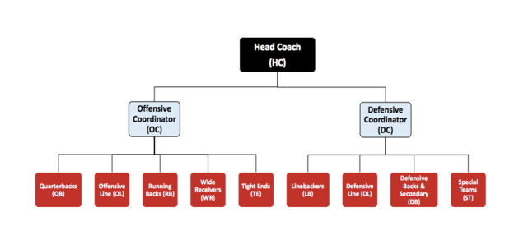
Understanding NFL coaching structure is important
Before we get into those two ways, let’s back up and explain the typical NFL team’s coaching structure.
Each team has a head coach, an offensive coordinator and a defensive coordinator. They are the big three, but below them you have a number of other smaller coaches, which are called position coaches. These people focus on more specific groups like quarterbacks, running backs, offensive lines, special teams and more.As you can see in the graphic above, there are a lot of position coaches on a typical team, but the critical thing to remember is this: Not all position coaches are created equal. Some are more likely than others to one day become coordinators, and, in turn, head coaches. For example, a running back coach is much less likely than a quarterback coach to, one day, become head coach.

Slide 4
﻿There are two main issues holding back black coaches
Understanding all that, here is the first issue: Black coaches at the beginning of their careers are getting put in the wrong jobs. They are getting the gigs that the researchers say have “inferior promotion prospects” as compared to white coaches at the same professional stage.
Let’s take the fast-rising quarterback coach and the water-treading running back coach. According to this research, between a white coach and a black coach, who is more likely to land a gig as a quarterback coach? The white coach. And who is more likely to start their career as a running back coach? The black coach.
These are just two examples, but the pattern holds across the entirety of position coaches. Or as the authors say it: “At the time of hire into their first NFL coaching position, white coaches tend to be allocated to positions with greater upward mobility prospects than black coaches.”
Now, the second issue: Once already hired, black coaches are less likely than white coaches to be rewarded and promoted for their efforts, once again giving them a more difficult route to the top of the coaching food chain.
As it stands right now, Georgetown’s Chris Rider and his co-authors estimate that white NFL position coaches are more than two times as likely to be promoted to coordinator than their black counterparts.

